Slide 1
OT Sermon PPT Format
Passage
Dr. Rick Griffith • Crossroads International Church Singapore
BibleStudyDownloads.org

Slide 2
Title
Passage
Dr. Rick Griffith, Crossroads International Church Singapore
BibleStudyDownloads.org

Slide 3
Need

Slide 4
Subject?

Slide 5
Background

Slide 6
Black on White

Slide 7
I. Main Point

Slide 8
Black on White

Slide 9
"Scripture" (6: NLT).

Slide 10
"Scripture" (6: NLT).

Slide 11
"Scripture" (6: NLT).

Slide 12
"Scripture" (6: NLT).

Slide 13
II. Main Point

Slide 14
"Scripture" (6: NLT).

Slide 15
"Scripture" (6: NLT).

Slide 16
"Scripture" (6: NLT).

Slide 17
"Scripture" (6: NLT).

Slide 18
III. Main Point

Slide 19
Main Idea
Text

Slide 20
Text

Slide 21
Text

Slide 22
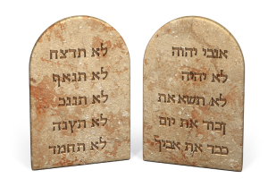
The Big Ten

Slide 23
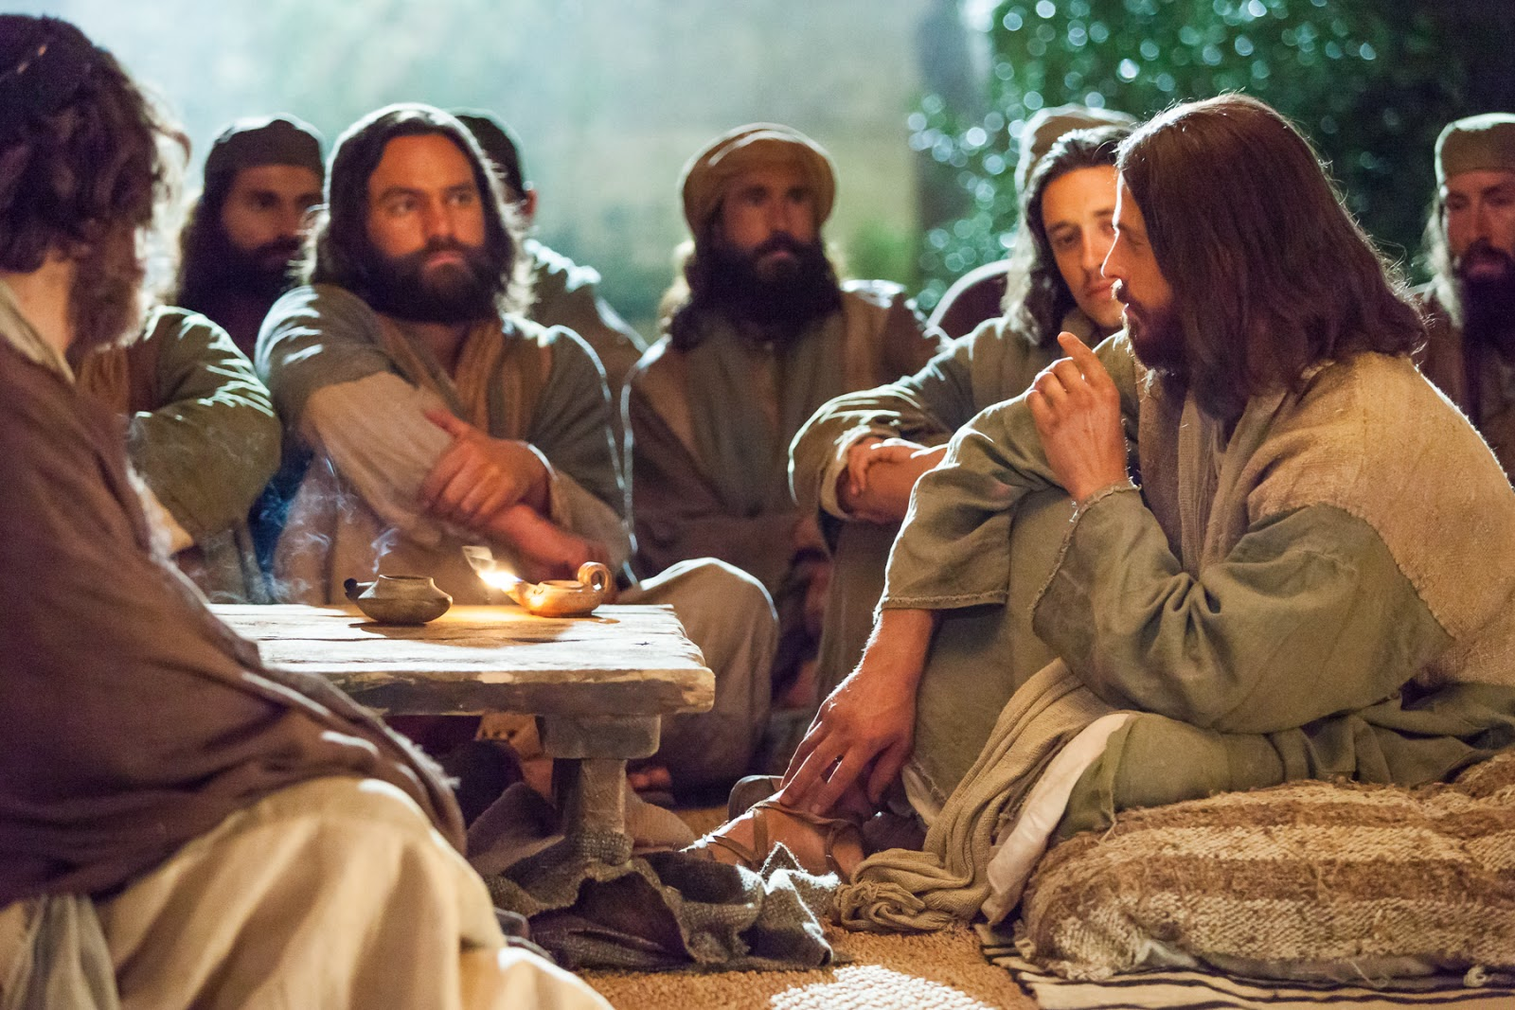
I. Main Point

Slide 24
Worship

Slide 25
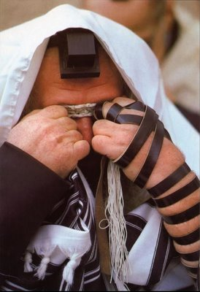
"Scripture" (6: NLT).

Slide 26
Black on White

Slide 27
"Scripture" (6: NLT).

Slide 28
"Scripture" (6: NLT).

Slide 29
"Scripture" (6: NLT).

Slide 30
"Scripture" (6: NLT).

Slide 31
"Scripture" (6: NLT).

Slide 32
"Scripture" (6: NLT).

Slide 33
Black on White

Slide 34
I. Main Point

Slide 35
"Scripture" (6: NLT).

Slide 36
"Scripture" (6: NLT).

Slide 37
"Scripture" (6: NLT).

Slide 38
"Scripture" (6: NLT).

Slide 39
Black on White

Slide 40
"Scripture" (6: NLT).

Slide 41
"Scripture" (6: NLT).

Slide 42
"Scripture" (6: NLT).

Slide 43
"Scripture" (6: NLT).

Slide 44
Black on White

Slide 45
I. Main Point

Slide 46
"Scripture" (6: NLT).

Slide 47
"Scripture" (6: NLT).

Slide 48
"Scripture" (6: NLT).

Slide 49
"Scripture" (6: NLT).

Slide 50
Entering the Kingdom of Heaven

Slide 51
Title
Explanation

Slide 52
Blue Background
EXILES
WORSHIPPERS
INTO

Slide 53
Blue Background
LIVE WELL
LAUGH OFTEN
LOVE MUCH

Slide 54
Blue Background
LIVE WELL
LAUGH OFTEN
LOVE MUCH

Slide 55
Blue Background
1
2
3
4

Slide 56
Black Text
Website

Slide 57
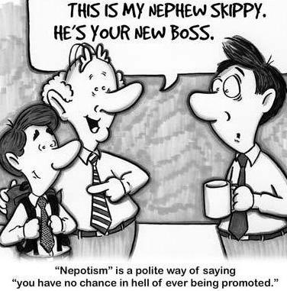
Nephew
This is my nephew, Skippy. He's your new boss.

Slide 58
Black Text
Website

Slide 59
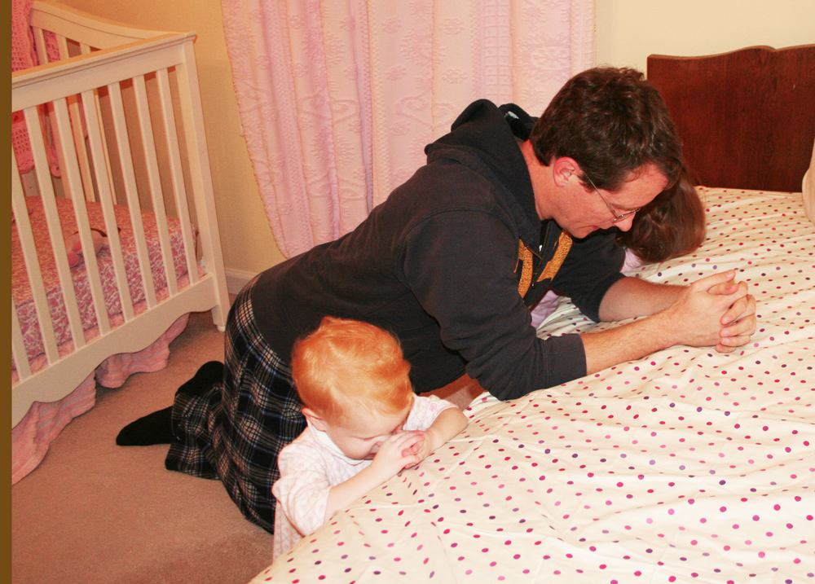
Title

Slide 60
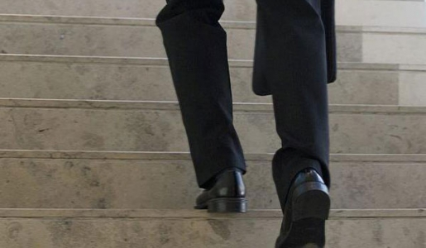
"Scripture" (Eccl. NLT).

Slide 61
Title

Slide 62
Title

Slide 63
Black

Slide 64
Black

Slide 65
OT Preaching link at biblestudydownloads.org
Get this presentation and script for free!

